Slide 1
Parallel Algorithms: Theory and Practice

Slide 2
Parallel algorithms Lecture 1
Why parallel algorithms?
About the course
Warm-up

Slide 3
When we study algorithms, what are we doing
Learning existing algorithms
Know how to solve existing well-defined problems
Design new algorithms
Model real-world problems and design new algorithms
Variants of existing algorithms
Combinations of existing algorithms
Analyze algorithms
Time complexity, space complexity, correctness, how accurate it is, …
Computational model, prove bounds and correctness, …
Implement algorithms
Programming-friendly algorithms
Implementation-level optimizations

Slide 4








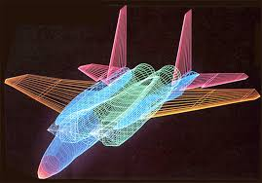
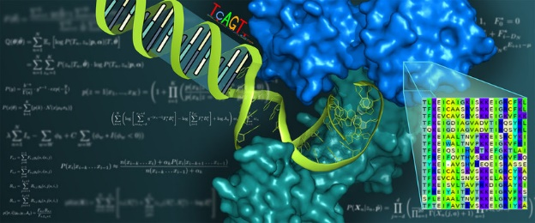


Why parallelism? Everyone wants performance!%aa
Database /
Data warehouses
Data mining /
Data science
Machine learning /
Artificial intelligence
Get Faster!
Many, many others
Computer graphics / computational geometry
Computational biology
Notes:
Before I start I would like to briefly introduce myself and my research. In computer science, we study algorithms and solutions for different applications, with different objectives and constrains, but almost every one wants performance! In the past, there is a rather trivial way to make your code faster, which is that you rely on the development of hardware. Roughly speaking you put your code there and wait for 1.5 years, your code runs faster by twice. But all of a sudden this bonus stopped. In the past ten years, the frequency of CPU improved by no more than twice. Even considering other aspects, it still became hard to improve the single-core performance.
That’s why we need parallelism! Exactly, parallelism moved into the mainstream of processor design at this point, and now, multicore devices are prevalent!
Now, parallelism is no longer limited to those expensive, high-end computers. These multi-core devices are in your office, on your desk, and even in your pocket! Although light-weighted, they are still powerful!
For example, a multicore machine can have terabytes of memory, which is more than enough for many applications of interest, and more than 100 available working threads, which implies a great a amount of parallelism. Even you don’t have such a machine, there are also online services that we can use, making parallelism applicable and affordable. So parallelism is getting more and more important and powerful nowadays. My research solves problems using such multi-core parallelism, both in theory and in practice.

Slide 5
Why performance? Time is money!
Analyzing a social network to provide real-time services (e.g, recommendation and advertising) - slow algorithms makes your information out-of-date
Answering queries from users (e.g., web searching and smart home) – slow algorithms makes users impatient and unhappy
Playing games, watching videos, video meetings, … - slow algorithms freeze the screen
Less time also means using less other recourse, like power

Slide 6
Time is money, it buys other things
There are many things more important than performance in programming
Compatibility, functionality, reliability, correctness, debuggability, robustness, … and more
Performance is the currency of computing. You can often “buy” needed properties with performance.
For an iterative numerical algorithm, spending more time means better accuracy
For a learning algorithm, training for more time means better model
Better performance means to get better results in a limited amount of time

Slide 7
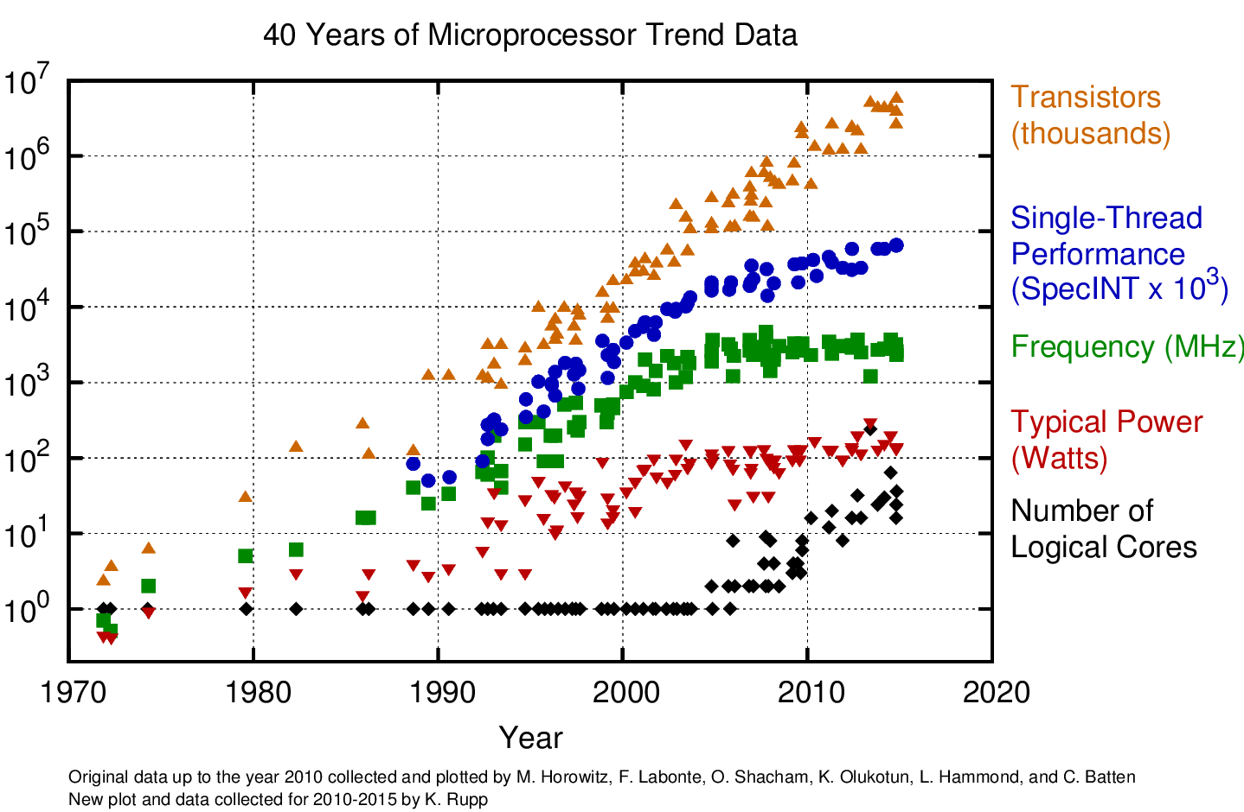
Ways to Make Code Faster
Solution 1: Wait… wait for better hardware
Makes sense 20 years ago
Writing parallel code is hard
Parallel speedup is not significant
Hardware improvement is stable

Slide 8
Ways to Make Code Faster
Solution 1: Wait… wait for better hardware, but:
Harder and harder to improve single-core performance

Slide 9
Ways to Make Code Faster
Multi-core machines came out right in time
Now, your laptop, desktop, smart phone, … are all multi-core
Multi-core programming became easier - relatively

Slide 10


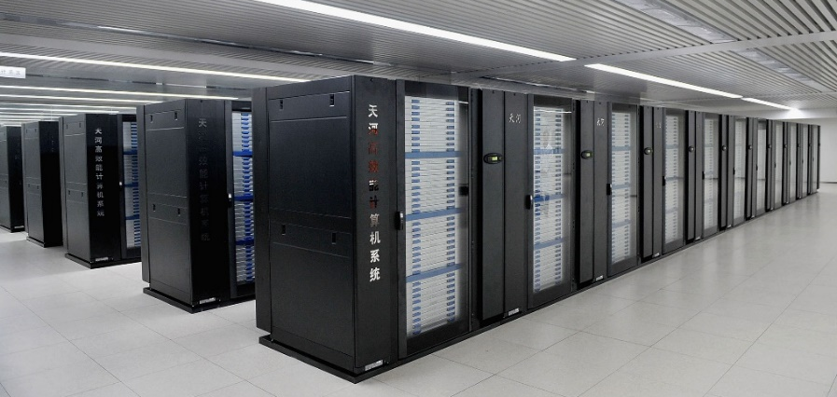
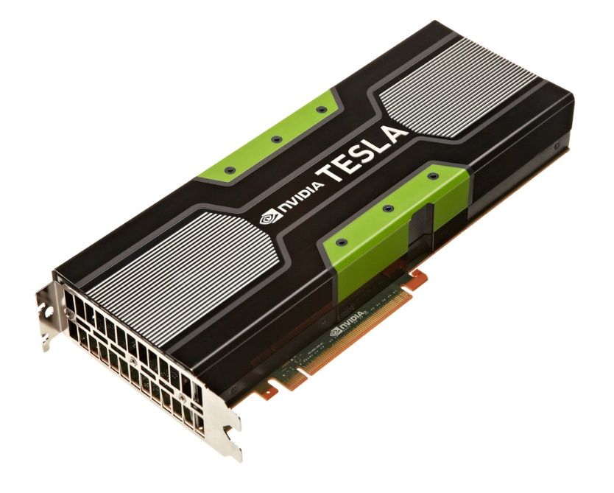

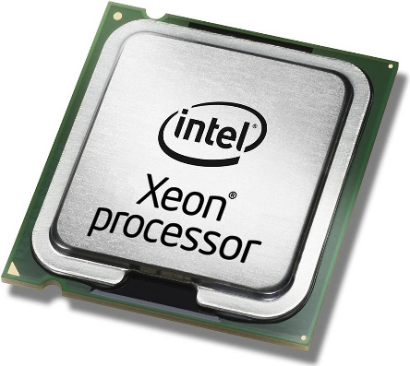
Ways to Make Code Faster: Parallelism
Shared-memory Multi-core Parallelism
Notes:
Before I start I would like to briefly introduce myself and my research. In computer science, we study algorithms and solutions for different applications, with different objectives and constrains, but almost every one wants performance!
Nowadays, an effective way to get your code faster is to use parallelism. There are many forms of parallelism in the world, and my talk will focus on the shared memory multi-core parallelism.
With the advent and prevalence of multi-core devices, parallelism is no longer limited to those expensive high-end computers, but can be light weighted and affordable. You can find such devices in your office, on your desk, and even in your pocket. Although light-weighted, they are still powerful.
For example, a multicore machine can have terabytes of memory, which is more than enough for many applications of interest, and more than 100 available working threads, which implies a great a amount of parallelism. Actually, when data fits in memory, we can expect very good performance from this multi-core shared-memory parallelism, because of smaller overhead in memory access compared to other forms of parallelism, so it’s also especially good for I/O intensive applications.

Slide 11
What you will learn in this course
Shared-memory Multi-core Parallelism
Multiple processors collaborate to get a task done
Notes:
Before I start I would like to briefly introduce myself and my research. In computer science, we study algorithms and solutions for different applications, with different objectives and constrains, but almost every one wants performance!
Nowadays, an effective way to get your code faster is to use parallelism. There are many forms of parallelism in the world, and my talk will focus on the shared memory multi-core parallelism.
With the advent and prevalence of multi-core devices, parallelism is no longer limited to those expensive high-end computers, but can be light weighted and affordable. You can find such devices in your office, on your desk, and even in your pocket. Although light-weighted, they are still powerful.
For example, a multicore machine can have terabytes of memory, which is more than enough for many applications of interest, and more than 100 available working threads, which implies a great a amount of parallelism. Actually, when data fits in memory, we can expect very good performance from this multi-core shared-memory parallelism, because of smaller overhead in memory access compared to other forms of parallelism, so it’s also especially good for I/O intensive applications.

Slide 12
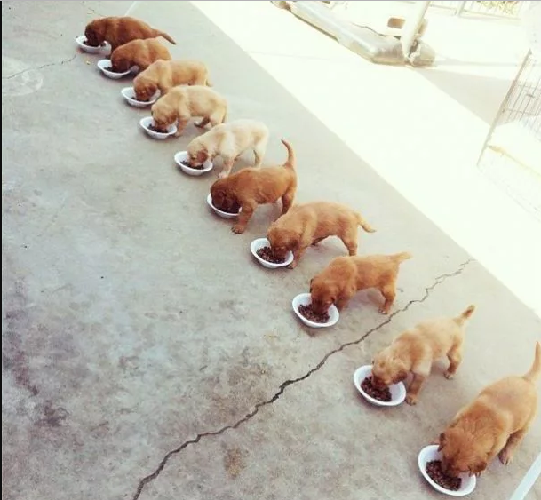
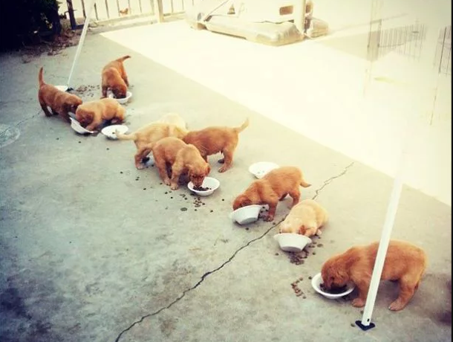
Multi-core Programming: Theory and Practice
Data Race: Two or more processors are accessing the same memory location, and at least one of them is writing
Memory leaking: memory which is no longer needed is not released
Deadlock: a state in which each member of a group is waiting for another member, including itself, to take action, such as releasing a lock
Zombie process: a process that has completed execution but still has an entry in the process table
Missing the 10th dog! Did it become a zombie???
Data Race
Deadlock!
Theory
Practice
Memory leaking!
(Pictures from 9gag.com)
Notes:
But to have both is not easy. Theories are always efficient and elegant, but when trying to bring them into reality, it’s easy to make it a mess. As you can see, there is always a gap between theory and practice. this gap is especially significant for parallel computing because,
parallel programming itself is hard. Usually only well-trained programmers can handle parallelism. If you’ve ever been tortured by parallel programming, you might get this joke: even if you want to get “parallel programming is hard” in parallel, it’s very likely you get this.

Slide 13
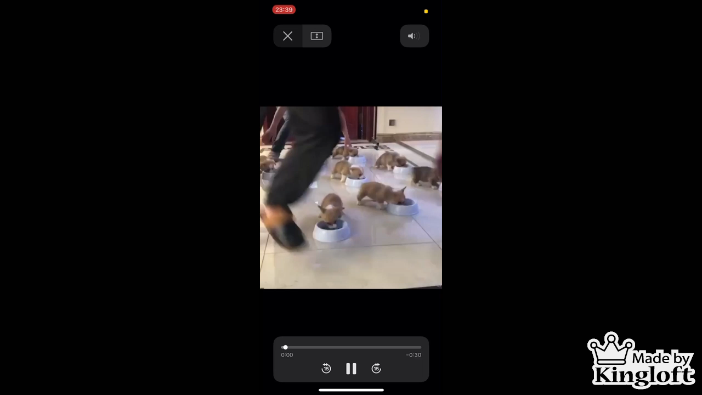
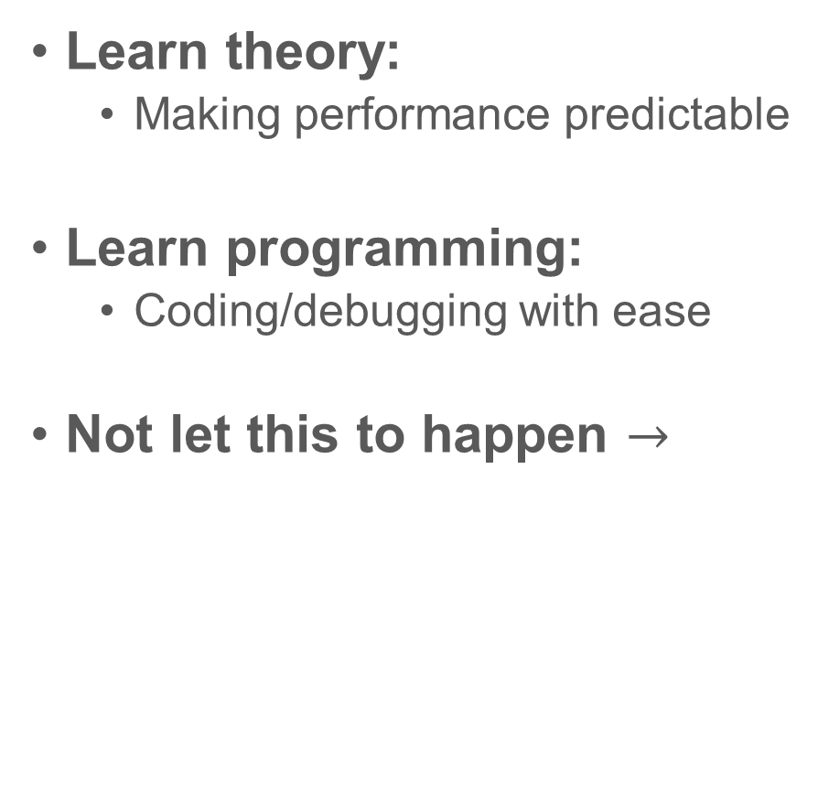
Multi-core Programming: Theory and Practice
Learn theory:
Making performance predictable
Learn programming:
Coding/debugging with ease
Not let this to happen $→$

Slide 14
About the Course
In theory:
Many parallel algorithms, their analysis and cost bound
How to design parallel algorithms
Algorithms with theoretical bounds
In practice:
Algorithms with practical consideration (e.g., I/O efficiency)
How to write high-performance code
Code that is easy to write and debug

Slide 15
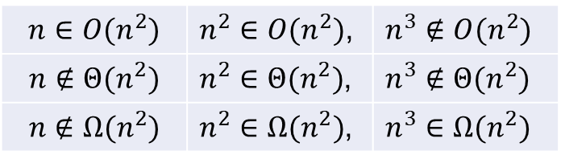
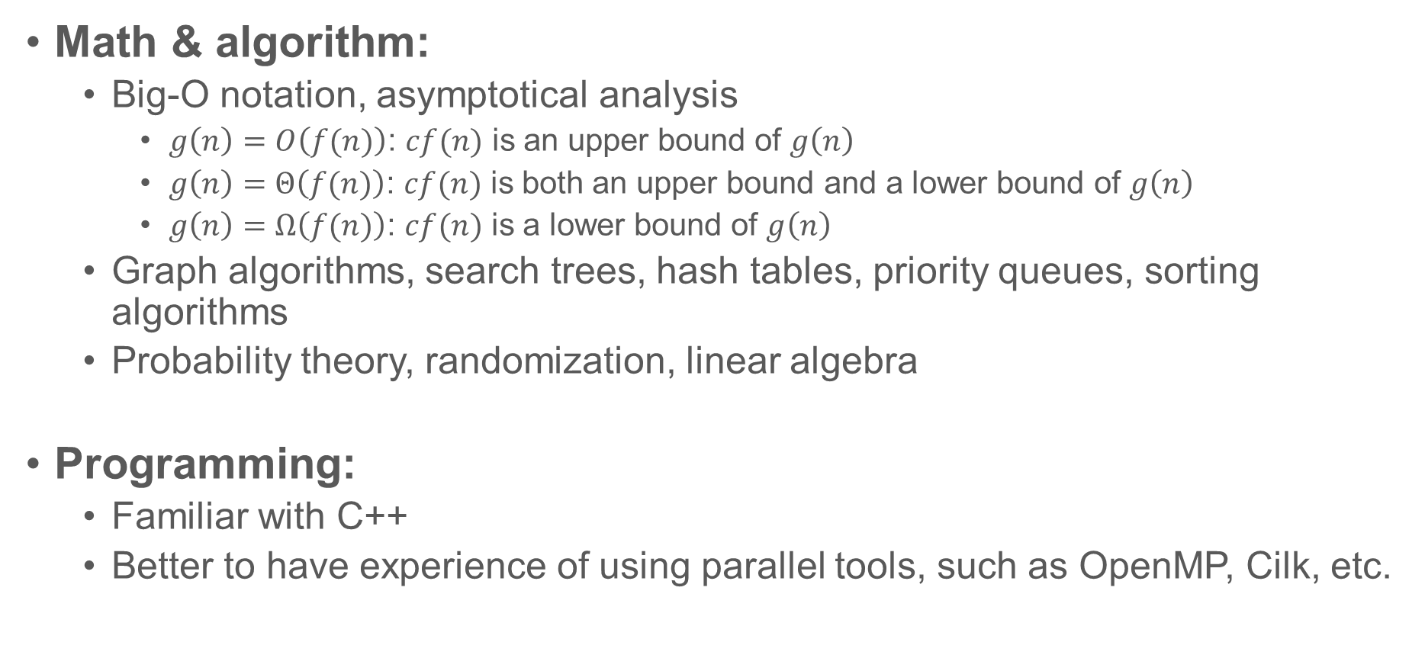
Prerequisites
Math & algorithm:
Big-O notation, asymptotical analysis
$g\left(n\right)=O\left(f(n)\right)$: $cf(n)$ is an upper bound of $g\left(n\right)$
$g\left(n\right)=Θ\left(f(n)\right)$: $cf(n)$ is both an upper bound and a lower bound of $g\left(n\right)$
$g\left(n\right)=Ω\left(f(n)\right)$: $cf(n)$ is a lower bound of $g\left(n\right)$
Graph algorithms, search trees, hash tables, priority queues, sorting algorithms
Probability theory, randomization, linear algebra
Programming:
Familiar with C++
Better to have experience of using parallel tools, such as OpenMP, Cilk, etc.
$$n∈O(n^{2})$$ | $n^{2}∈O(n^{2})$, | $n^{3}∉O(n^{2})$
$$n∉Θ(n^{2})$$ | $n^{2}∈Θ(n^{2})$, | $n^{3}∉Θ(n^{2})$
$$n∉Ω(n^{2})$$ | $n^{2}∈Ω(n^{2})$, | $n^{3}∈Ω(n^{2})$

Slide 16
Course Project
Simple implementations about the algorithms learned in the class
Three topics: sorting algorithms, tree algorithms, graph algorithms
You can choose one of these topics
Larger teams (2-3 students) or other topics are allowed, but
Must talk to the lecturer before submitting the proposal
Significantly higher standard applies
What you can do
Design new algorithms
Experimental evaluations
Prove new results
Project proposal due at the end of Week 5
Project presentation at Week 10

Slide 17
Class Participation (up to 5 points)
Answering questions in the class will earn you extra points
Just tell me your name after each class
Other ways to earn points
Give good suggestions about the course or point out typos/unclear things in the slides or homework assignments
If your homework is selected as the sample solution

Slide 18
Warm-up: reduce Compute the sum of values in an array

Slide 19
Warm-up: the reduce algorithm
Compute the sum of all values in an array (using $p$ processors)
1
+
2
+
3
4
+
5
+
6
7
+
8
6
+
15
+
15
36
Sum(A, n) {
int B[p];
for processor i (i=0..p-1) {
for (j=i*n/p to i*n/p+p) B[i] += A[j];
}
sync all processors;
for (j = 0 to p) ret += B[i];
return ret; }
What if:
We do not know the number of available processors?
The number of processors is O(n)?

Slide 20
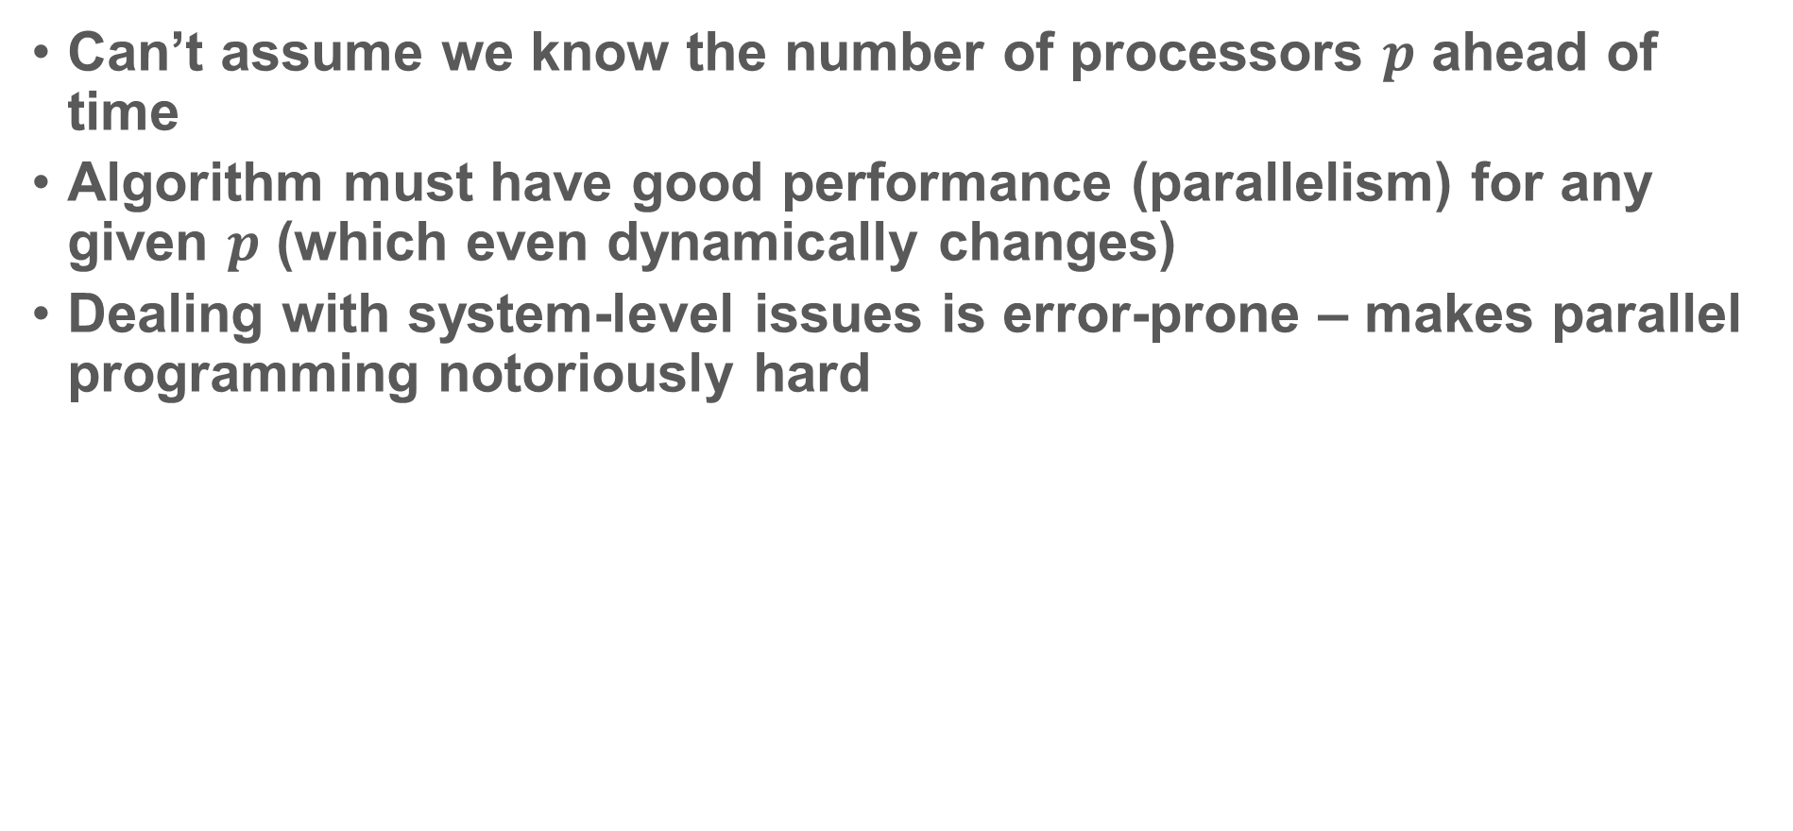
Problems
Can’t assume we know the number of processors $p$ ahead of time
Algorithm must have good performance (parallelism) for any given $p$ (which even dynamically changes)
Dealing with system-level issues is error-prone – makes parallel programming notoriously hard

Slide 21
Scheduler: the key to make parallel algorithm design easy

Slide 22

Scheduler
Program
The program generate threads (tasks)
The scheduler maps each thread to a processor (e.g., whenever a processor is available)
Scheduler

Slide 23

Scheduler
Consider it as a complier. Programmers then only need to focus on high-level algorithm design
Code in high-level language
Generate parallel tasks and their dependency
Complier
Scheduler
Executable machine code
Parallel execution order using $p$ processors
We always assume an effective scheduler
We design algorithms only focusing on generating parallel tasks

Slide 24
Warm-up
Compute the sum (reduce) of all values in an array
1
2
3
4
5
6
7
8
+
+
+
+
3
+
7
11
+
15
10
26
+
36
reduce(A, n) {
if (n == 1) return A[0];
if (n is odd) n=n+1;
parallel_for i=1 to n/2
B[i]=A[2i]+A[2i+1];
return reduce(B, n/2); }
reduce(A, n) {
if (n == 1) return A[0];
In parallel:
L = reduce(A, n/2);
R = reduce(A + n/2, n-n/2);
return L+R;
}

Slide 25
How to evaluate the running time (time complexity) of a parallel algorithm (without knowing how many processors can be used)

Slide 26
Cost model: work-depth
For all computations, draw a DAG
A->B means that B can be performed only when A has been finished
Work: the total number of operations
Depth (span): the longest length of chain
It only shows the dependency of operations in the algorithm

Slide 27
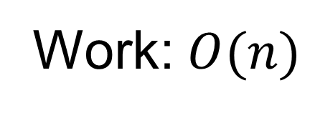
Cost model: work-depth
1
2
3
4
5
6
7
8
+
+
+
+
3
+
7
11
+
15
10
26
Work: $O(n)$
+
36
Work: The total number of operations in the algorithm
Sequential running time when the algorithm runs on one processor
Work-efficiency: the work is (asymptotically) no more than the best (optimal) sequential algorithm
Goal: make the parallel algorithm efficient when a small number of processor are available

Slide 28
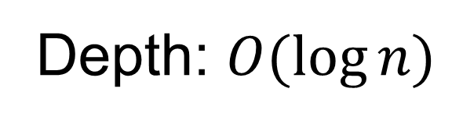
Cost model: work-depth
1
2
3
4
5
6
7
8
+
+
+
+
3
+
7
11
+
15
10
26
Depth: $O(\log{n})$
+
36
Depth (span): The longest dependency chain
Total time required if there are infinite number of processors
Polylog-depth
Goal: make the parallel algorithm faster and faster when more and more processors are available - scalability

Slide 29
How do work and depth relate to the real execution and running time?

Slide 30
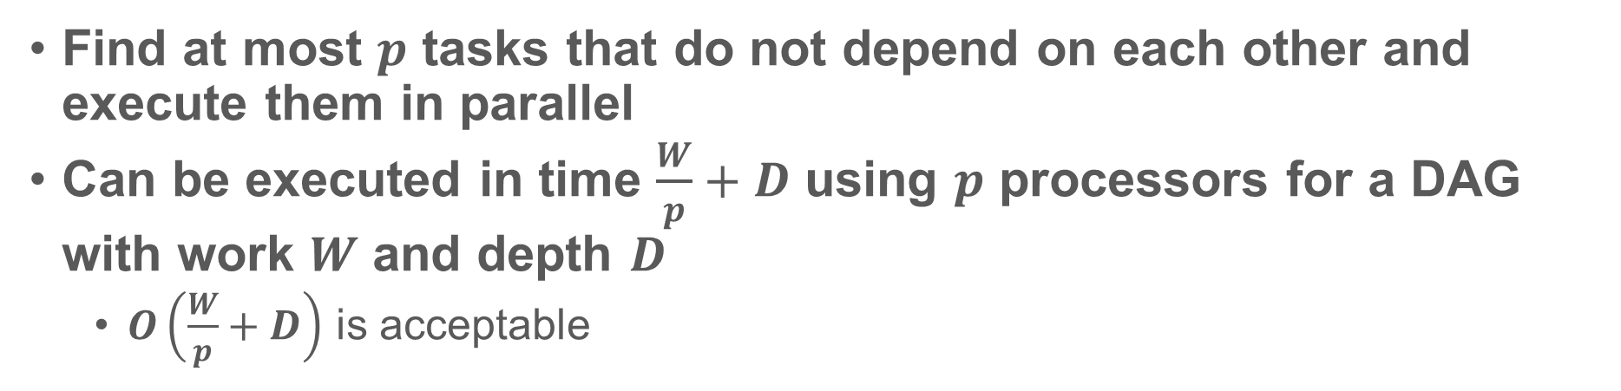
Reduce – how to schedule it?
Round 1
Round 2
1
2
3
4
5
6
7
8
+
+
+
+
Round 3
3
+
7
11
+
15
Round 4
10
26
+
36
Find at most $p$ tasks that do not depend on each other and execute them in parallel
Can be executed in time $\frac{W}{p}+D$ using $p$ processors for a DAG with work $W$ and depth $D$
$O\left(\frac{W}{p}+D\right)$ is acceptable

Slide 31
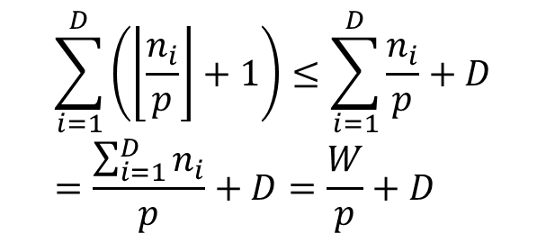
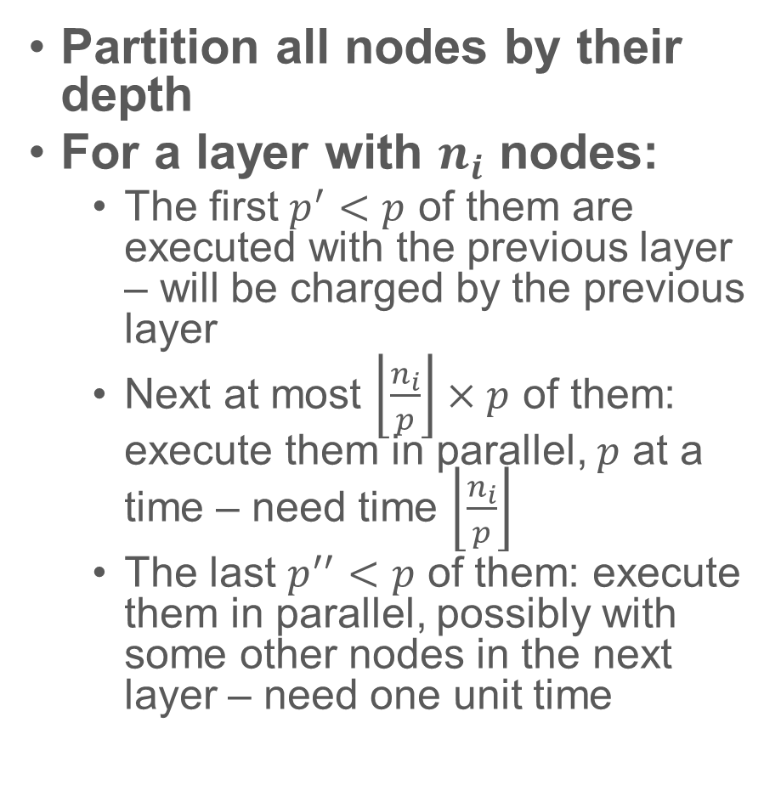
How to schedule it?
1
2
Partition all nodes by their depth
For a layer with $n_{i}$ nodes:
The first $p^{′}<p$ of them are executed with the previous layer – will be charged by the previous layer
Next at most $\left\lfloor \frac{n_{i}}{p}\right\rfloor ×p$ of them: execute them in parallel, $p$ at a time – need time $\left\lfloor \frac{n_{i}}{p}\right\rfloor$
The last $p^{′′}<p$ of them: execute them in parallel, possibly with some other nodes in the next layer – need one unit time
3
4
5
6
7
8
$$\sum_{i=1}^{D}{\left(\left\lfloor \frac{n_{i}}{p}\right\rfloor +1\right)}≤\sum_{i=1}^{D}{\frac{n_{i}}{p}}+D=\frac{\sum_{i=1}^{D}{n_{i}}}{p}+D=\frac{W}{p}+D$$

Slide 32
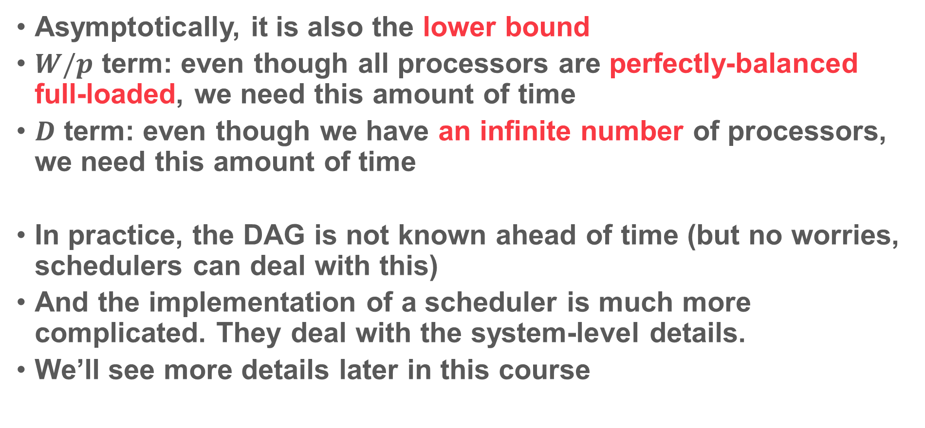
$W/p+D$: How good is it?
Asymptotically, it is also the lower bound
$W/p$ term: even though all processors are perfectly-balanced full-loaded, we need this amount of time
$D$ term: even though we have an infinite number of processors, we need this amount of time
In practice, the DAG is not known ahead of time (but no worries, schedulers can deal with this)
And the implementation of a scheduler is much more complicated. They deal with the system-level details.
We’ll see more details later in this course

Slide 33
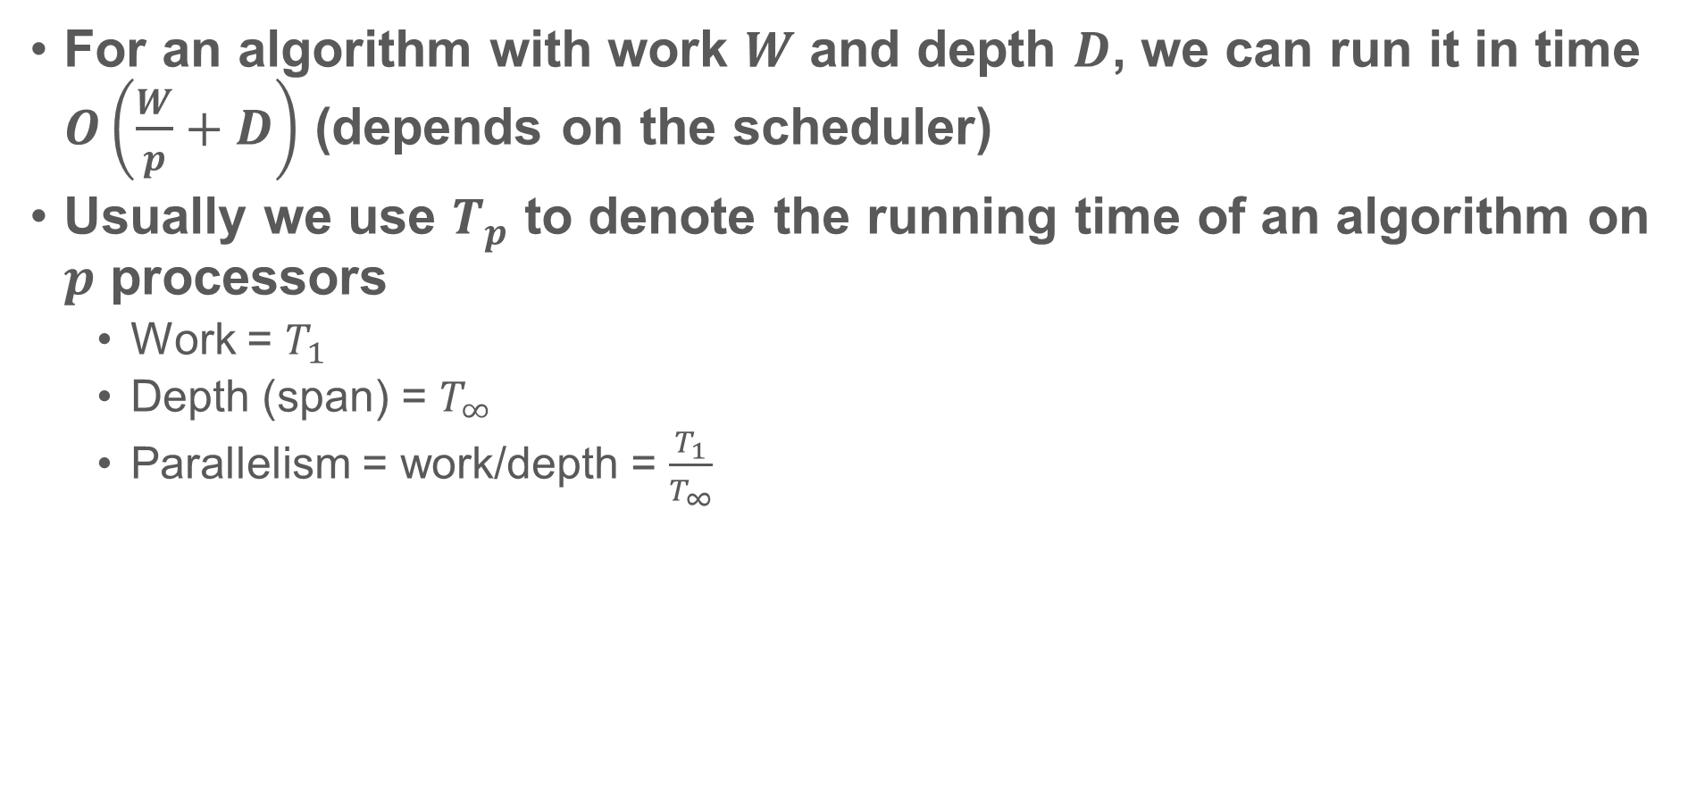
Work-depth model
For an algorithm with work $W$ and depth $D$, we can run it in time $O\left(\frac{W}{p}+D\right)$ (depends on the scheduler)
Usually we use $T_{p}$ to denote the running time of an algorithm on $p$ processors
Work = $T_{1}$
Depth (span) = $T_{∞}$
Parallelism = work/depth = $\frac{T_{1}}{T_{∞}}$

Slide 34
Next class
No class/office hours on Wednesday.
Scan algorithm
Computational models: PRAM, fork-join, etc.
Divide-and-conquer, solve recurrence
Parallel programming tools

